Slide 1


Digital Signal Processing
  Zhou Hang

Slide 2
Introduction
Definition of FIR Digital Filters
Characteristics of FIR Digital Filters
Specifications of FIR Digital Filters
Design of FIR Digital Filters

Slide 3
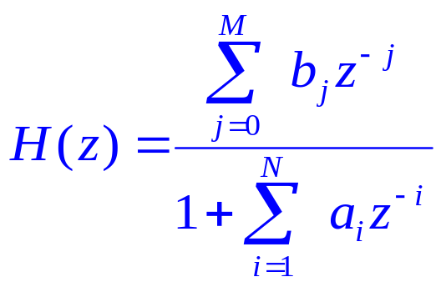
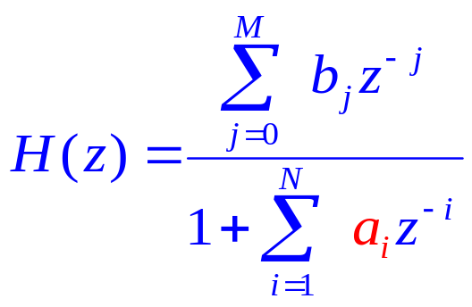
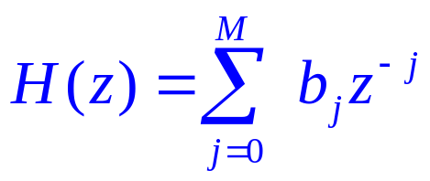
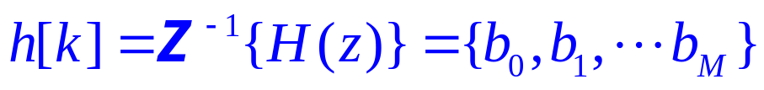
1. Definition of FIR Digital Filters
Discrete LTI System
Finite Length Impulse Response
If a_{i}=0
FIR（ Finite Impulse Response ）Digital Filters

Slide 4
Introduction
Definition of FIR Digital Filters
Characteristics of FIR Digital Filters
Specifications of FIR Digital Filters
Design of FIR Digital Filters

Slide 5
2. Characteristics of FIR Digital Filters
IIR
FIR
The system may be unstable
FIR system is always stable
The system has non-linear phase
The system can have a linear phase

Slide 6
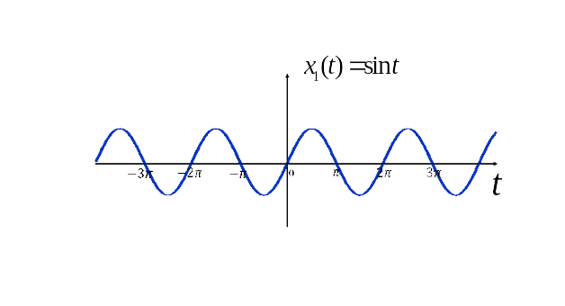
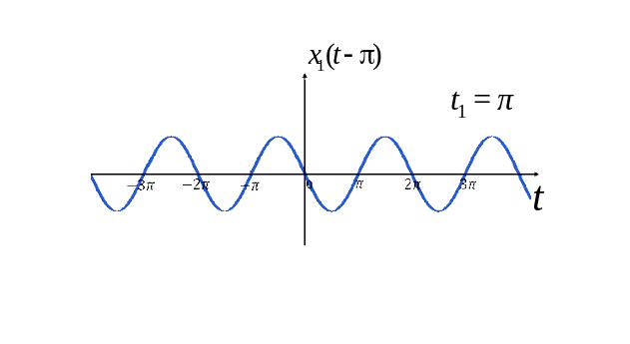
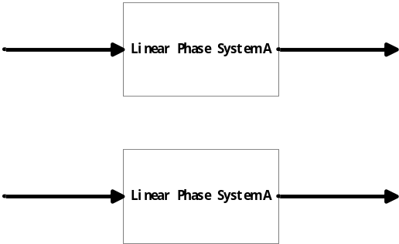
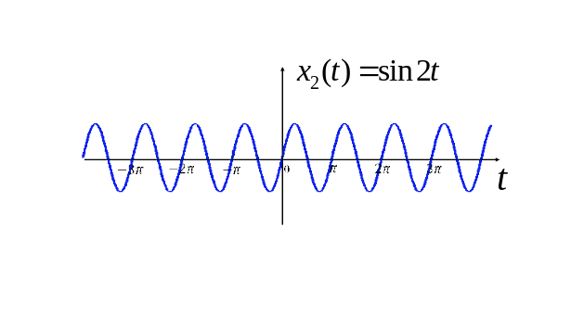
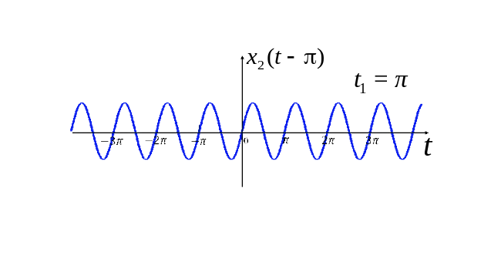
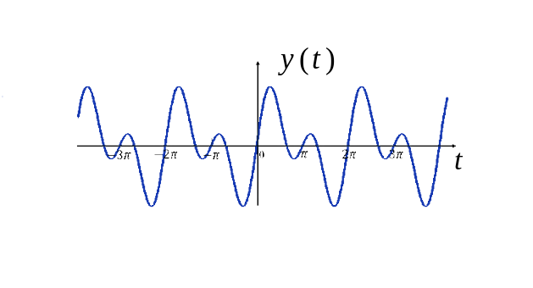
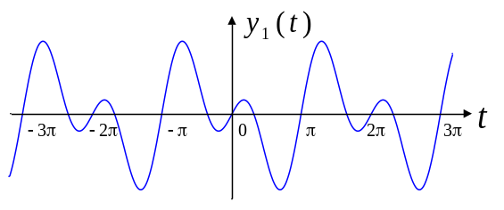
2. Characteristics of FIR Digital Filters
Linear phase
+
+

Slide 7
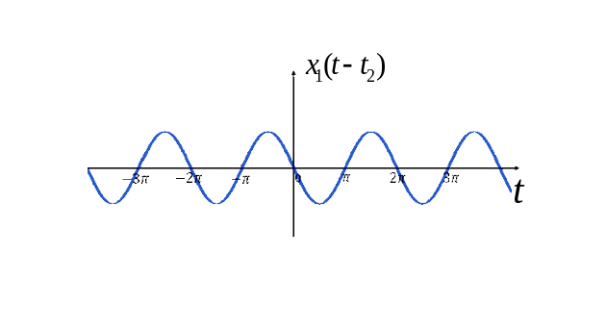
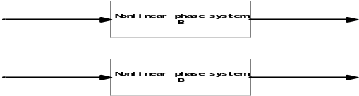
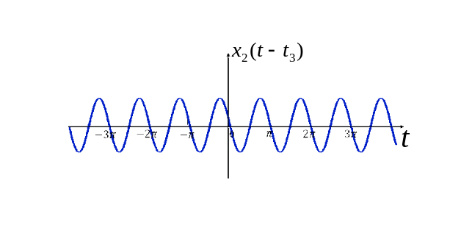
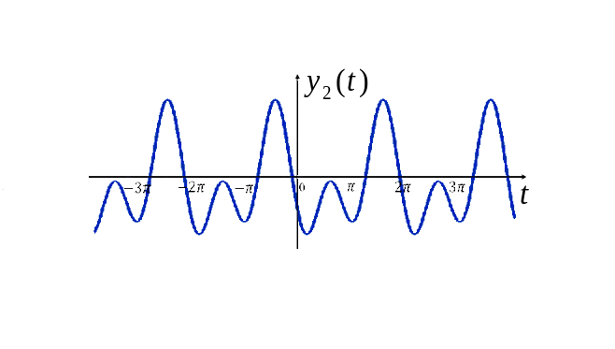
2. Characteristics of FIR Digital Filters
Linear phase
Different
Time delay
+
+

Slide 8
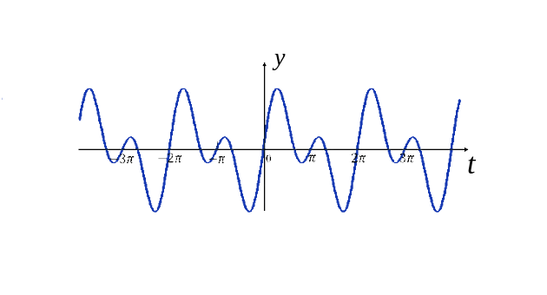
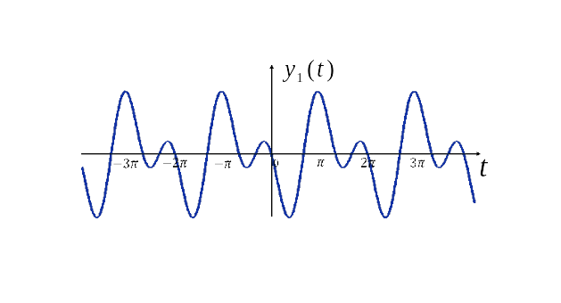
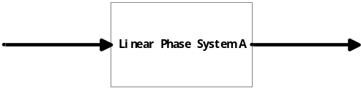
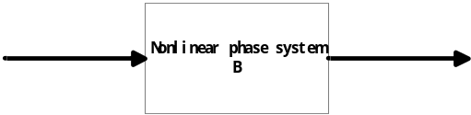
2. Characteristics of FIR Digital Filters
Linear phase
"Compared to the original superimposed signal, there is only a time delay."
Signal distortion

Slide 9
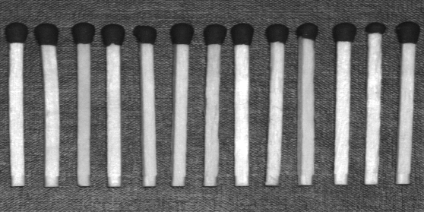
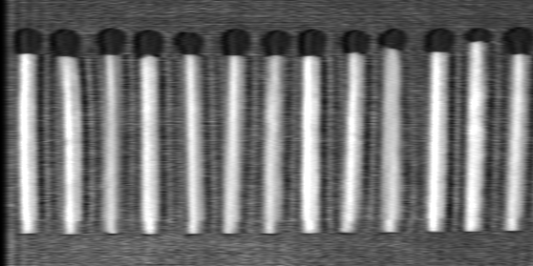
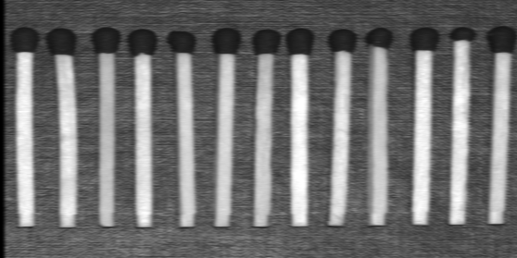
2. Characteristics of FIR Digital Filters
Original image
Passing through a non-linear phase system
Passing through a linear phase system

Slide 10
Introduction
Definition of FIR Digital Filters
Characteristics of FIR Digital Filters
Specifications of FIR Digital Filters
Design of FIR Digital Filters

Slide 11
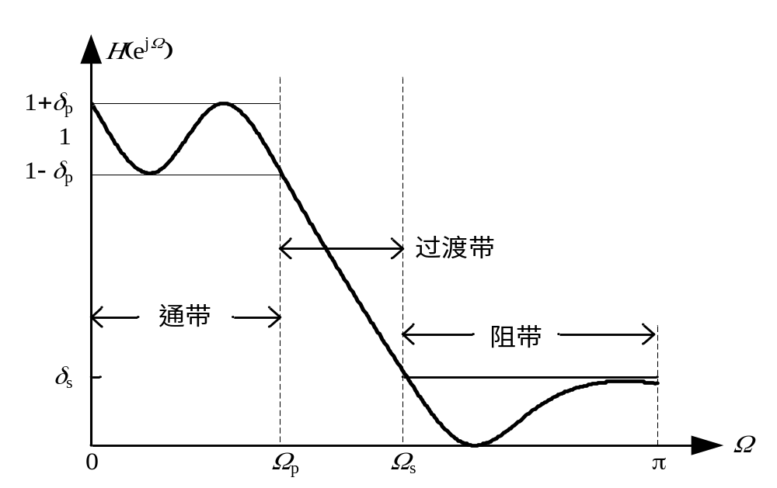




3. Specifications of FIR Digital Filters
Ω_{p}:Passband Edge Frequency
δ_{p}:Passband Ripple
Maximum Passband Attenuation(dB)
Ω_{s}: Stopband Edge Frequency
Transition zone
δ_{s}: Stopband Ripple
Passband
Minimum Stopband Attenuation(dB)
Stopband

Slide 12
Introduction
Definition of FIR Digital Filters
Characteristics of FIR Digital Filters
Specifications of FIR Digital Filters
Design of FIR Digital Filters

Slide 13
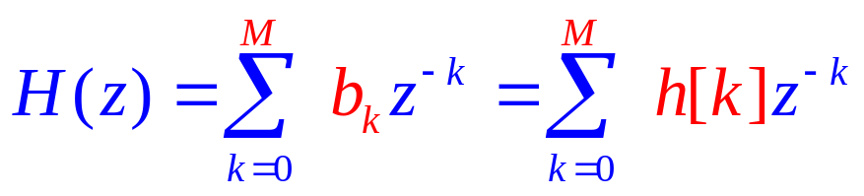
4. Design of FIR Digital Filters
Design of Digital Filters: Determine the digital filter system function H(z) based on the given design specifications.
For FIR digital filters, due to
Therefore, in designing FIR digital filters, it is only necessary to determine h[k].

Slide 14
4. Design of FIR Digital Filters
Common Methods for FIR Filter Design:
Windowing Method
Frequency Sampling Method
Optimal Design Method

Slide 15
Thanks
The materials referenced in this course are accumulated over years of teaching by the instructor, sourced from various media and exchanges with colleagues and peers. It is difficult to indicate the source of each material one by one. This is to clarify and express gratitude.

